Slide 1


Supervised by:
Dr. Hanaa Bayoumi
Final Presentation

Slide 2
Our team
Ahmed Mohamed Sallam
Mohamed Gamal Abdelaziz
Farah Tawfik Salem
Omar Walid Ahmed
Mohamed Gaber Mohamed
20210614
20201146
20200378
20201126
20200436
Graduation Project
Academic Year 2023-2024

Slide 3

01 Introduction

Slide 4
Introduction
Al-Maqraa, designed to aid Muslims in Quranic learning.
Focuses on improving pronunciation and memorization accuracy.
Recognizing the Quran's significance in Islam.
This platform supports the religious obligation of memorizing and accurately reciting the sacred text.
Al-Maqraa aims to bridge the gap by providing a technologically advanced solution that utilizes speech recognition and analysis to objectively evaluate Quranic recitations.

Slide 5
02 Motivation

Slide 6
Motivation
Commitment to making Quranic learning accessible to Muslims globally especially for non-Arabic speakers
Aid Muslims to overcome two significant obstacles : pronunciation and memorization.
Scheduling conflicts and distance limitations could hinder the one from learning
Al-Maqraa seeks to close this gap by enabling users to practice and get feedback at any time

Slide 7
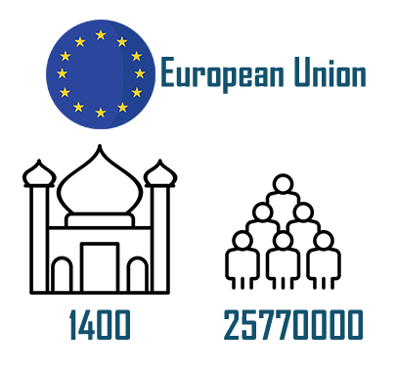
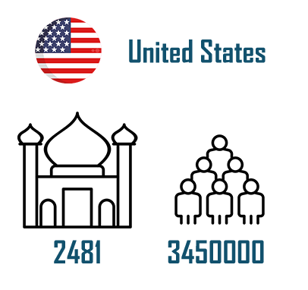
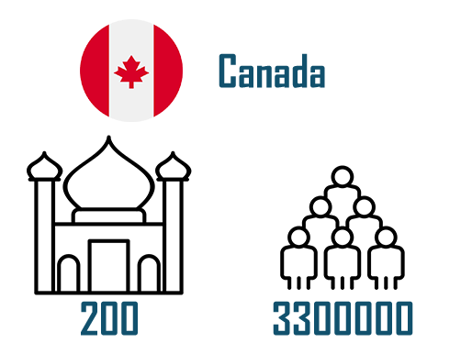
Non- Muslims Country

Slide 8
03 Problem significance

Slide 9
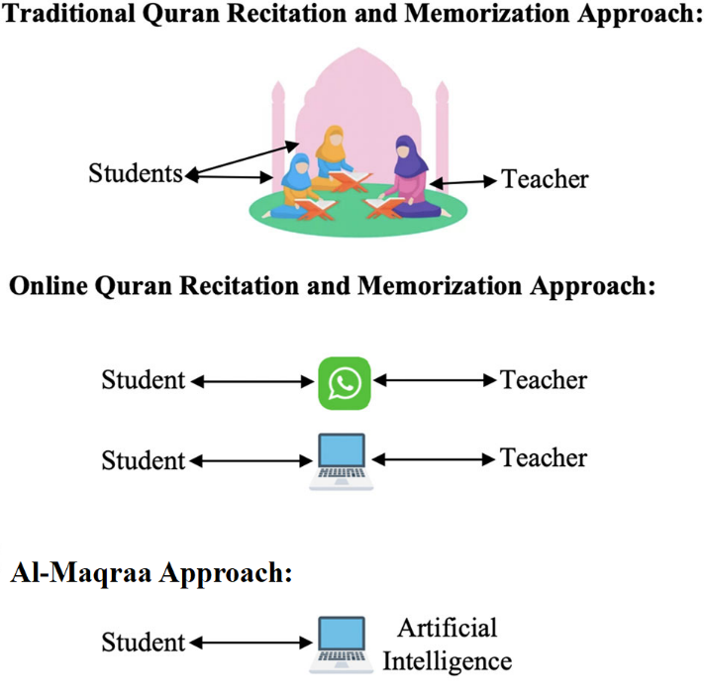
The lack of mosques in western countries is a major obstacle for Muslims to look for guidance and teaching for the Quran.
Fixed timing for sheikh instructions makes it difficult for people to study Quran at their convenience.
The absence of immediate feedback on individual recitation impedes the learning process.
the majority of systems available checks if the text has been committed to memory; they do not check if the pronunciation is correct.

Slide 10
04 Related Work

Slide 11
Commercial Application

Slide 12



 | Tarteel | Tamkeen | Tasmee
Android & IOS
Free
Support diacritics?
Type of error the app focuses on
Streaks & Session history
Obvious errors
Hidden errors

Slide 13
Existing Literature Reviews

Slide 14
Subject | Recitation recognition | Recitation veriﬁcation | Traditional speech recognition methods | End-to-end speech recognition methods | Audio feature extraction techniques | Datasets | Mobile applications | Traditional Models | End-to-end Models
Veriﬁcation system for Quran recitation recordings (Sherif Mahdi Abdo & Ayat Hafzalla ,2017) | ✓ | ✗ | ✓ | ✗ | ✓ | ✗ | ✗ | ANN HMM VQ
Deep Diacritics-Based Recognition Model for Arabic Speech (Sarah S. Alrumiah,2023) | ✓ | ✓ | ✗ | ✓ | ✓ | ✓ | ✗ |  | TDNN-CTC RNN – CTC Transformer
Intelligent Quran Recitation Recognition and Veriﬁcation: Research Trends and Open Issues (Sarah S. Alrumiah, 2023) | ✓ | ✓ | ✓ | ✓ | ✓ | ✓ | ✓ | HMM GMM VQ K-Means SVM TDNN | LSTM MaLSTM HMM+BLSTM

Slide 15
05 Challenge

Slide 16
Computational Power
1
Training Models: Training deep learning models is computationally intensive, requiring high-performance hardware, which is often limited and costly.
Real-Time Inference: Providing immediate feedback necessitates robust computational infrastructure for real-time inference, handling multiple requests without delays.
Scalability: As the user base grows, the application must scale efficiently. Limited resources can hinder scalability, affecting performance and accessibility.
Cost Constraints: Balancing computational power needs with budget constraints is challenging. High-performance computing resources are expensive, especially during initial development.

Slide 17
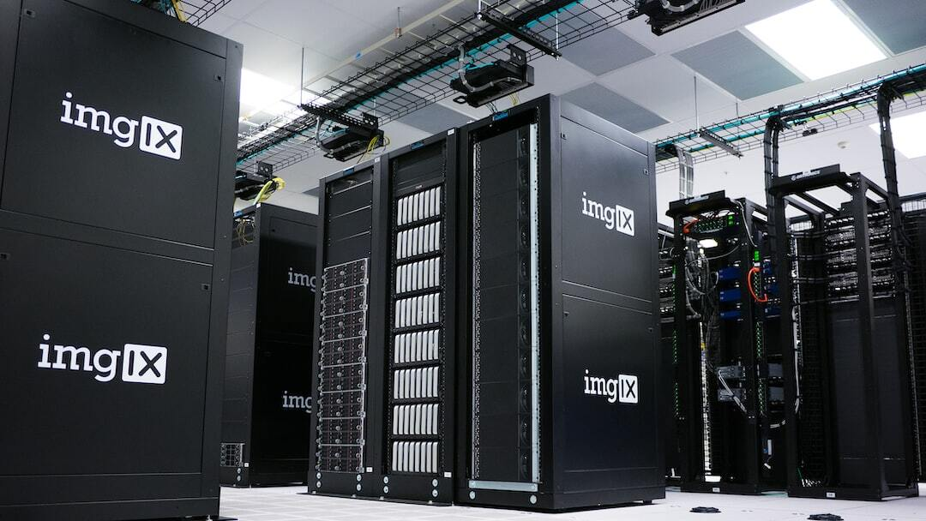
Bibliotheca Alexandrina
2
Communication Issues: Delays in responses and unclear communication channels with the team at Bibliotheca Alexandrina have hindered timely issue resolution and coordination.
Insufficient Information: Inaccurate and insufficient information about HPC resources complicates planning and optimizing computational tasks.
Outdated Hardware: Old HPC machines at Bibliotheca Alexandrina result in slower processing times and may not support the latest ML technologies and frameworks.

Slide 18

"روى الترمذي وأبو داود واللفظ له ، عن عبد الله بن عمرو رضي الله عنهما قال : قال رسول الله صلى الله عليه وسلم : ( يُقَالُ لِصَاحِبِ الْقُرْآنِ : اقْرَأْ وَارْتَقِ وَرَتِّلْ ، كَمَا كُنْتَ تُرَتِّلُ فِي الدُّنْيَا ، فَإِنَّ مَنْزِلك عِنْدَ آخِرِ آيَةٍ تَقْرَؤُهَا ) "

Slide 19
06 Machine Learning Approach

Slide 20
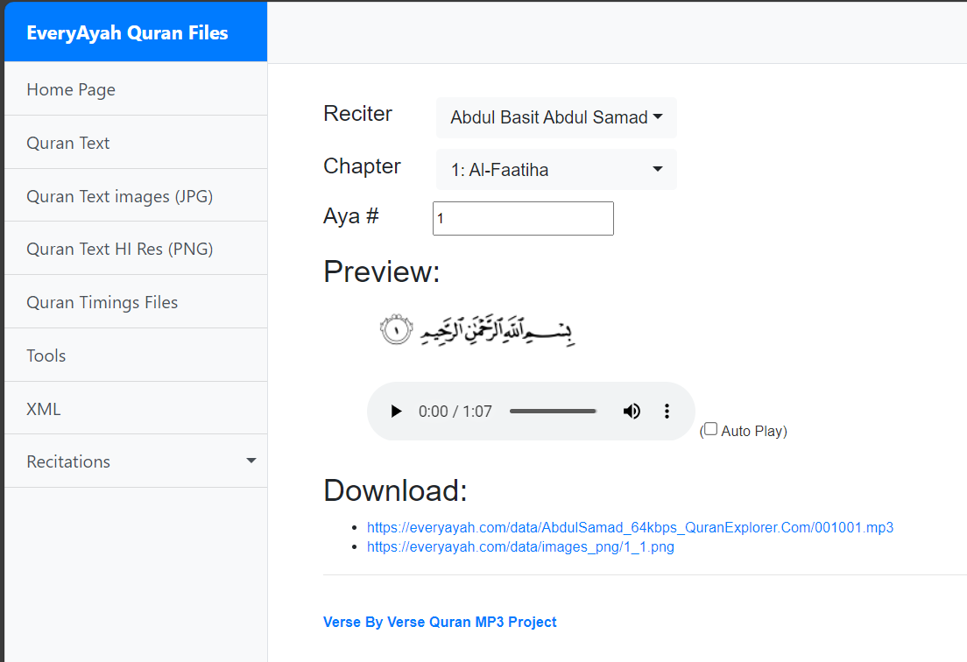
Raw Data (Data Set)
EveryAyah Dataset
- Whole Quran
- Have 7 Male Expert
- Each imam is separated from the other
- Have 6236 Wav file

Slide 21
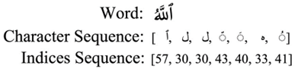
Character-Based Arabic Vectorization and Indexing
• Character Classes: Each character in Arabic, including letters, diacritics, symbols, and a space character, is treated as a class and assigned a specific index.
• Conversion Process: Character sequences in verses are converted to sequences of indices. This process aids in character-based speech recognition.

Slide 22
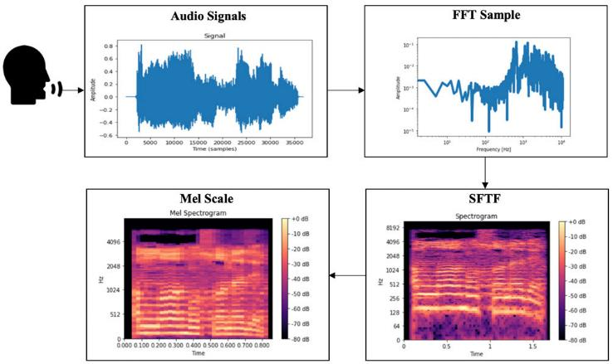
Conversion of Audio Signals to Mel-Spectrograms
To process audio signals, we first convert them into Mel-spectrograms, This is done using the Short-Time Fourier Transform, which applies Fast Fourier Transforms to overlapping segments of the audio over time. The FFT transforms a time-domain signal into its frequency-domain representation, making it ideal for analysing non-periodic signals like audio.
Next, we apply the Mel scale to these spectrograms, mimicking human hearing by perceiving frequencies uniquely. This conversion prepares the audio signals for input into models.

Slide 23
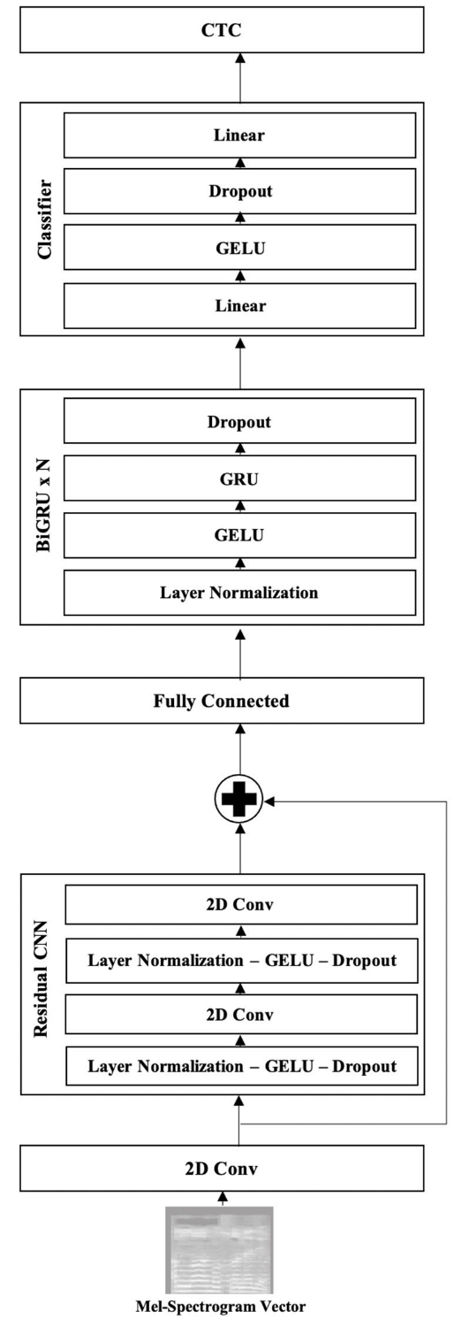
RNN Speech Recognition Model with CTC
Comprises five layers of hidden units:
First three and last layers: Non-recurrent.
Fourth layer: RNN processing data bidirectionally.
Uses Connectionist Temporal Classification (CTC) loss to align encoder outputs with character sequences.
Struggles with large and continuous speech datasets due to a single recurrent layer in the encoder.

Slide 24
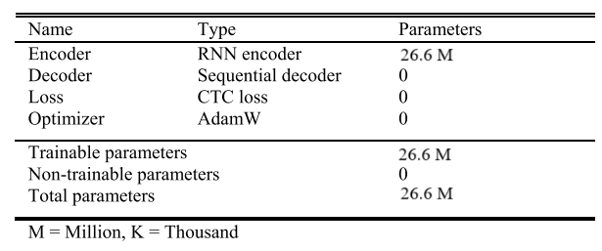
RNN Speech Recognition Model with CTC
Introduces multiple CNN and RNN layers.
Architecture: One CNN layer, five Gated Recurrent Unit (GRU) layers, and one fully connected layer.
Achieves the lowest Word Error Rate (WER) compared to other CNN-RNN combinations.
RNN-CTC Model:
Constructed based on Deep Speech 2 architecture for superior recognition performance.

Slide 25
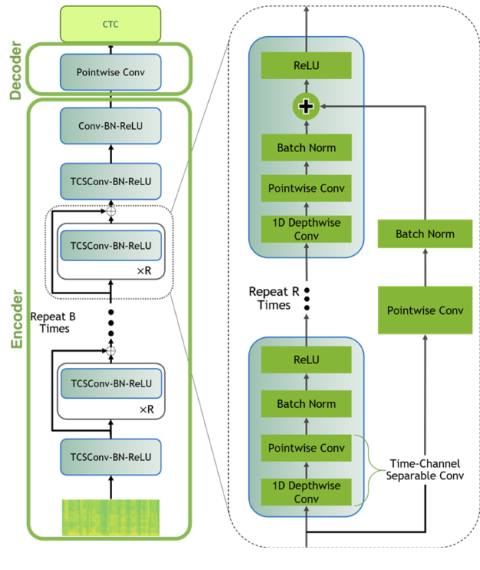
TDNN Speech Recognition Model with CTC
Widely used in traditional and hybrid speech recognition systems.
Uses depthwise separable convolutions instead of 1D convolutions.
Splits the kernel into depthwise and pointwise convolutions to handle spatial and depth dimensions, reducing complexity and speeding up the network.

Slide 26
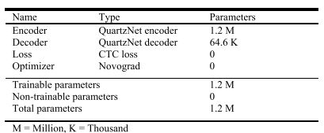
TDNN Speech Recognition Model with CTC
Model Components: Encoder, decoder, and CTC loss.
Encoder: Based on QuartzNet architecture with 15 repeated blocks, each containing five sub-blocks.
Decoder: A linear classification layer converting encoder outputs into probabilities for 63 classes (62 characters + 1 blank for CTC loss).
CTC Loss: Maps highest probability class to its character representation using a greedy decoder.

Slide 27
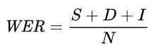
Evaluation Method
We used the Word Error Rate (WER) to evaluate the performance of our speech recognition models. WER, measures the accuracy of a speech recognition model based on the number of deleted (D), inserted (I), and substituted (S) words in the recognized text. It is calculated using the formula:
where NNN is the number of words in the target (reference) text. WER evaluates word recognition performance by considering deletions, insertions, and substitutions of words. The word accuracy for each model was determined by subtracting the WER value from 1.

Slide 28
Experimental Details
Models | Epochs | Batch size | Learning rate | Optimizer | Accuracy
TDNN-CTC | 168 | 32 | 0.01 | Novgard | 50%
RNN-CTC | 20 | 8 | 0.005 | AdamW | 70%

Slide 29
Results and Insights
RNN-CTC Model: Demonstrated superior accuracy (70%) compared to the TDNN-CTC model (50%).
Advanced Architecture: Incorporates CNN and BiGRU layers.
Optimizer: Utilized AdamW optimizer, contributing to better performance.
TDNN-CTC Model: Achieved 50% accuracy with the Novgard optimizer.
The results emphasize the importance of model architecture and optimization techniques in developing effective speech recognition systems, highlighting the enhanced performance of the RNN-CTC model.

Slide 30
07 Software Specifications

Slide 31

Developers
Experts
Stakeholders
Users
AI engineer

Slide 32
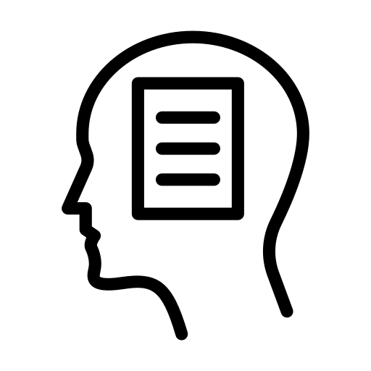





Functional Requirements
Authentication
Quran Memorization
Quran Recitation
Daily Tracker
Bookmarking
User could login and sign up
User can repeat and practice memorized verses.
Recite a specific (Ayahs)
Visual representations of daily progress
Favourites
Add Ayahs to favorites list
Save last page

Slide 33




Non-Functional Requirements
Security
Performance
Maintainability
Protect user’s data
Acceptable Response time
Portability
Can work IOS, android
Implement a maintainable code
Usability
User interface easy to navigate

Slide 34
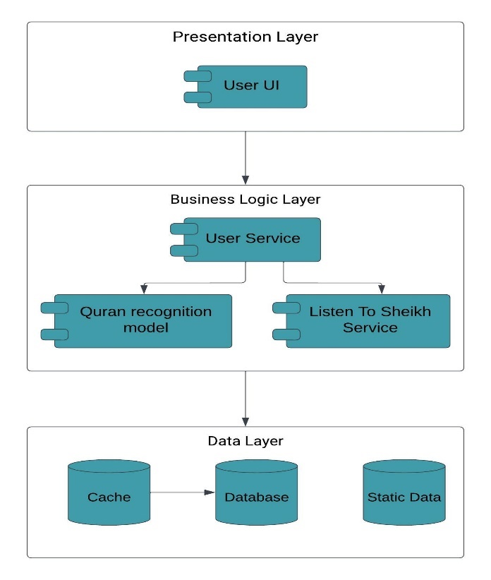
System Architecture
Layered architecture
Why?
Add level of abstraction.
Ease of development.
Reduced dependency.
Testing is easier.

Slide 35
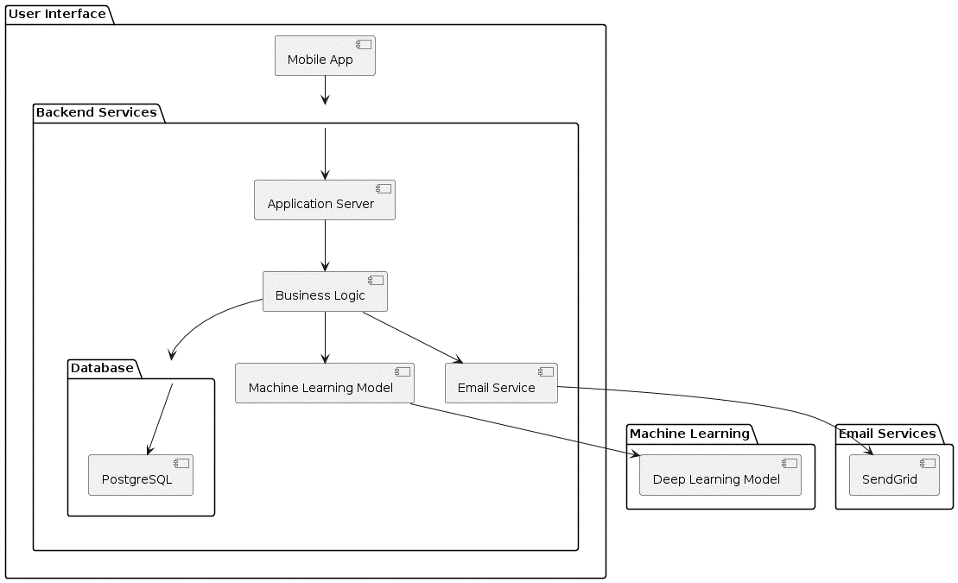
System Component Diagram

Slide 36
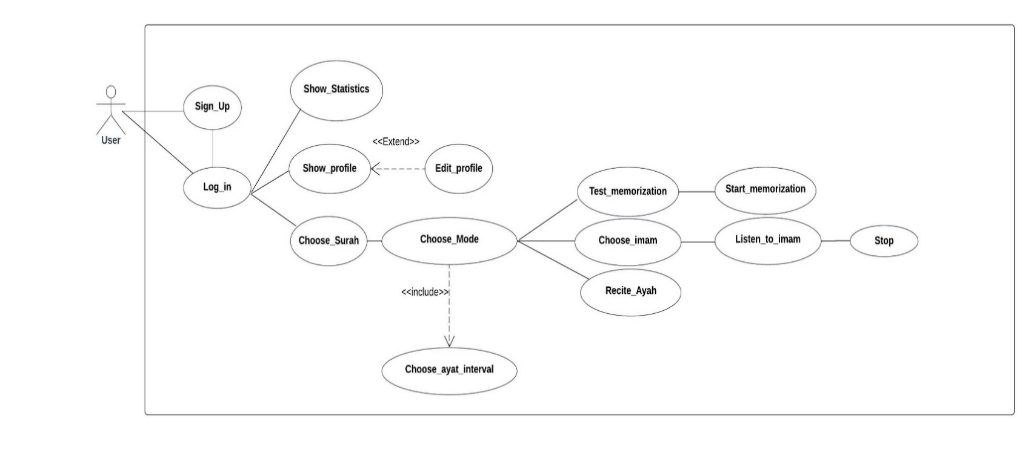
Use Case

Slide 37
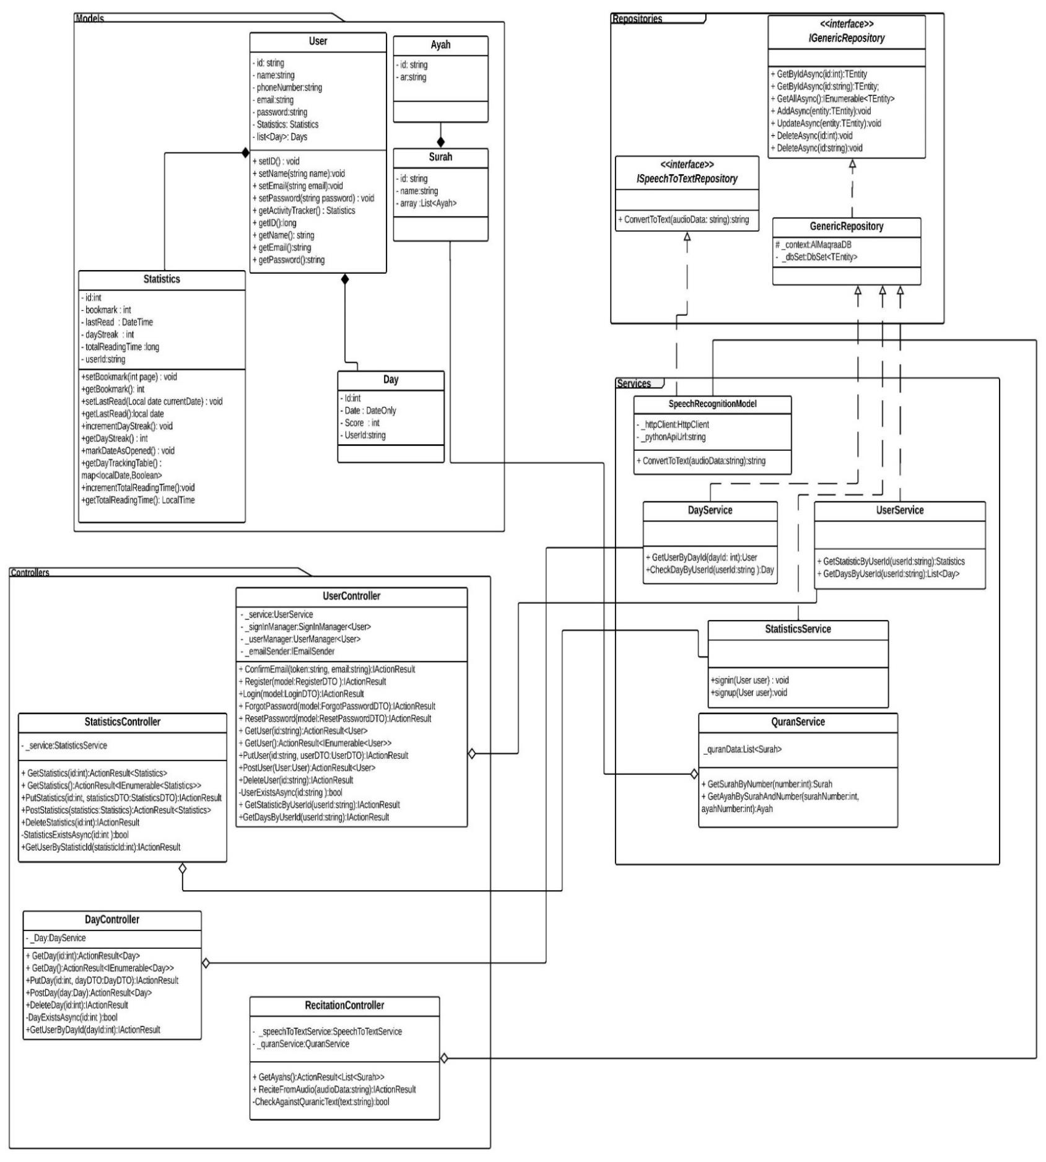
Class Diagram

Slide 38
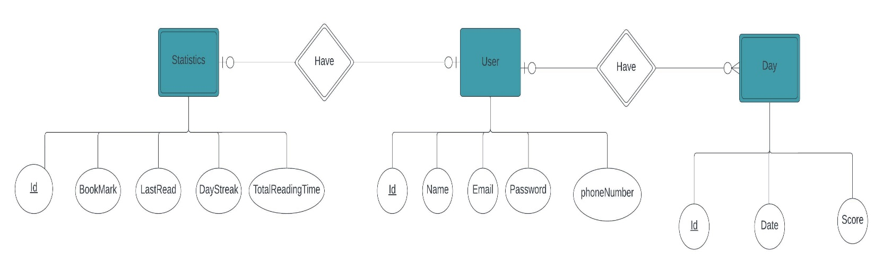
ERD

Slide 39
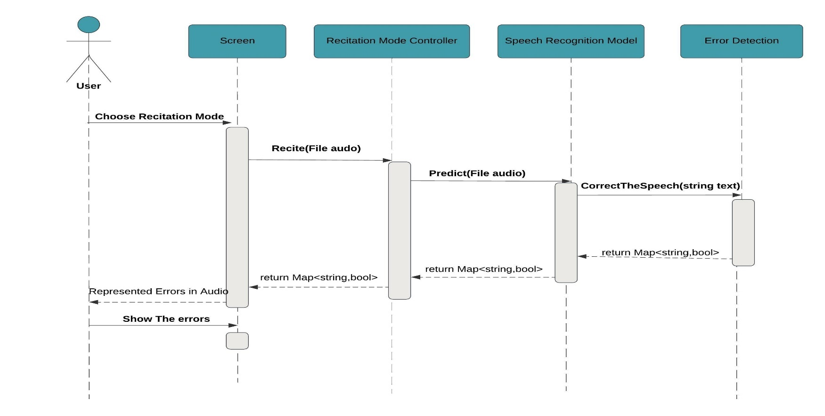
Sequence Diagram Recitation Mode

Slide 40
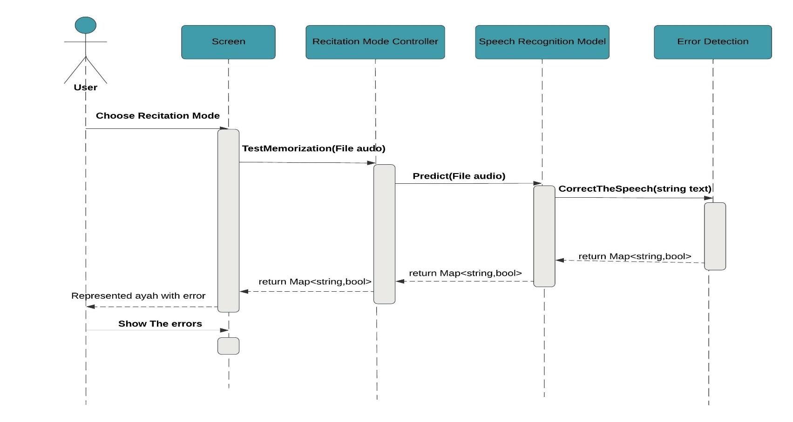
Sequence Diagram Test Memorization Mode

Slide 41
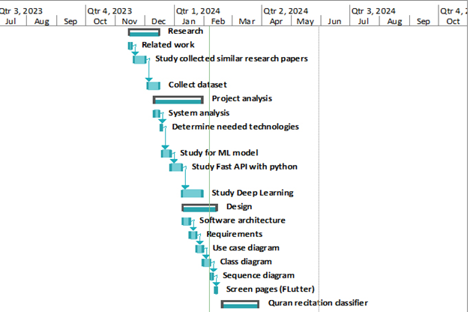
Time Plan

Slide 42
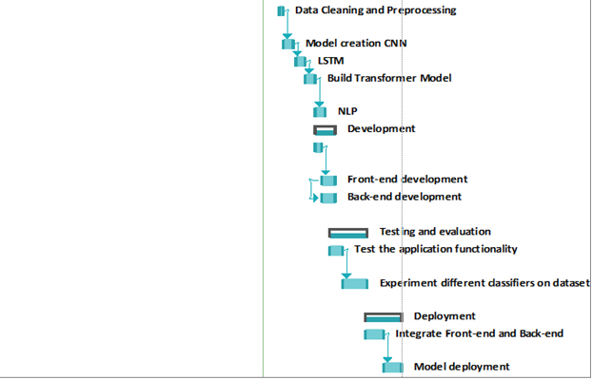
Time Plan

Slide 43
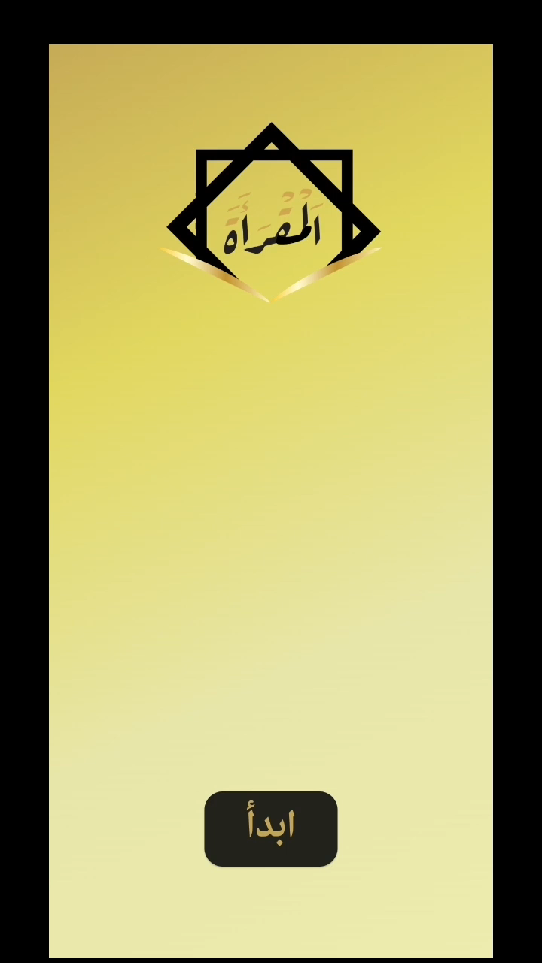
Mobile Demo

Slide 44
08
Conclusion

Slide 45
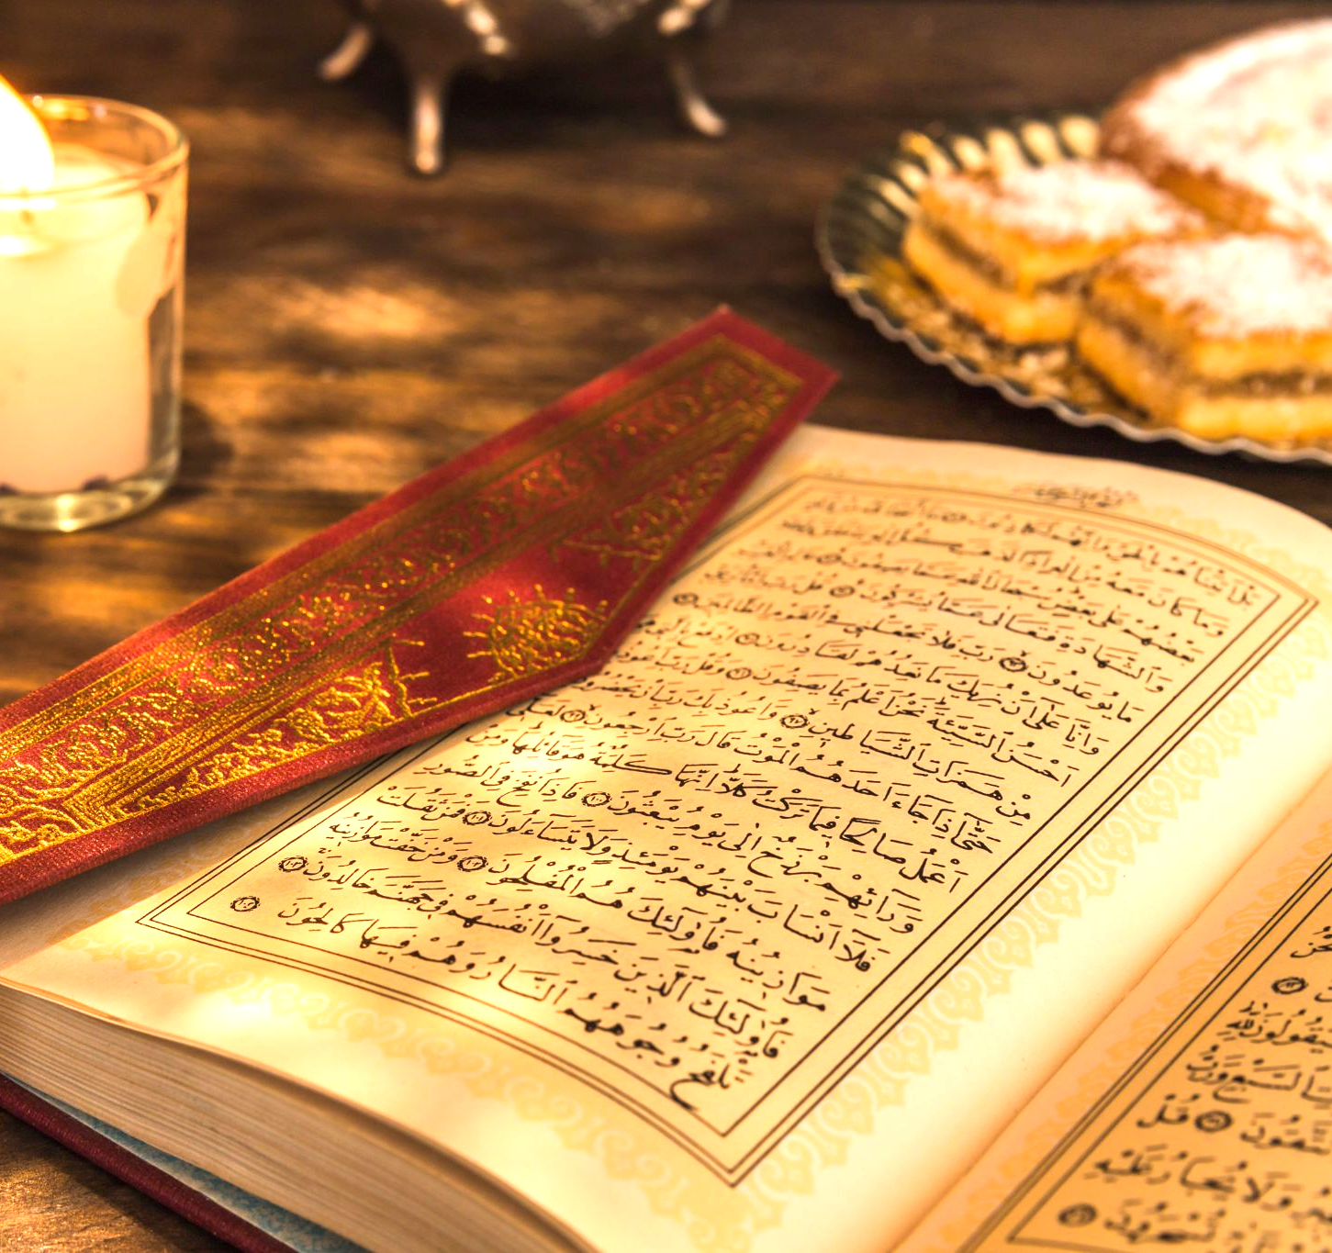
Conclusion
Al-Maqraa serves as a modern, accessible, and personalized solution for Quranic learning. Empowering individuals to engage with the Quran at their convenience.
"الماهر بالقرآن مع السفرة الكرام البررة، والذي يقرأ القرآن ويتعتع فيه وهو عليه شاق له أجران"

Slide 46
Thank You

